Slide 1
with open('data.csv') as f:
rows = f.readlines()
process(rows)
PYTHON PROGRAMMING · CO5_AT3
# auto-closes file
File Handling
Reading, Writing & Processing Data with Python Files
Technical Presentation · Topic 3 of 5
D
Deshaboina Dileep Kumar
Reg. No: 192424281RC | SIMATS Engineering
1

Slide 2
What We'll Cover
A practical walkthrough of Python file handling
01
Why File Handling?
02
Modes & Core Functions
Persisting data beyond program execution
open(), close(), read/write modes, the with statement
03
Reading Files
04
Writing Files
read(), readline(), readlines() in action
write(), writelines() and creating new files
05
Case Study
06
Live Output
A real program: reading a CSV, processing it, writing results
Console run and the generated results file
2

Slide 3
Why File Handling?
Variables and lists disappear the moment a program ends — files let data outlive the program.
File Lifecycle
1
Open the file
•
Persistence
Store results, logs, or records permanently on disk
2
Read or write data
•
Data exchange
Share structured data (CSV/JSON/TXT) between programs and people
3
Process / transform
•
Large data handling
Process datasets too big to keep only in memory
4
Close the file
•
Automation
Read inputs and write reports without manual re-entry
Tip: use with open(...) as f: — it closes the file automatically, even on errors.
3

Slide 4
File Modes & Core Functions
Every file operation starts with open(path, mode)
Mode
Meaning
Behavior
'r'
Read (default)
File must exist
# Safe way: auto-closes the file
with open("marks.txt", "r") as f:
'w'
Write
Creates new / overwrites existing
data = f.read()
'a'
Append
Adds to end of file
print(data)
'r+'
Read & write
File must exist
# Manual open/close
f = open("marks.txt")
'x'
Exclusive create
Fails if file exists
f.close() # must remember!
Key functions
open() open a file close() release it read()/readline()/readlines() pull data in write()/writelines() push data out
4

Slide 5
Reading Files
Three ways to pull content out of a file
read()
readline()
readlines()
Reads the entire file as a single string
Reads just one line, moves the cursor forward
Reads all lines into a list of strings
read_demo.py
with open("students.csv", "r") as f:
whole_file = f.read() # entire content as one string
with open("students.csv", "r") as f:
first_line = f.readline() # reads just the header row
with open("students.csv", "r") as f:
all_lines = f.readlines() # list: one string per line
for line in all_lines:
print(line.strip())
5

Slide 6
Writing Files
Pushing data out to disk
write(string)
write_demo.py
Writes one string; no automatic newline
results = [
"Name,Total,Average,Status\n",
writelines(list)
"Arun Kumar,255,85.0,PASS\n",
"Divya Priya,93,31.0,FAIL\n",
Writes a list of strings back to back
]
mode "w"
with open("results.csv", "w") as f:
Overwrites the file / creates it if missing
f.writelines(results)
# Append a late entry without
mode "a"
# erasing what's already there
Appends to the end, keeping old content
with open("results.csv", "a") as f:
f.write("Eshwar Rao,228,76.0,PASS\n")
6

Slide 7
Case Study: Student Marks Processor
A complete program that reads a CSV file, processes the data, and writes results to a new file
1
READ
2
PROCESS
3
WRITE
students.csv
in memory
results.csv
Open the CSV and read each student's name, roll no. and three subject marks
Compute total & average marks, then decide PASS / FAIL against the cutoff
Write a brand-new CSV with the computed columns for every student
→
→
Business rule: average of the 3 subject marks ≥ 40 → PASS, otherwise → FAIL. Uses Python's built-in csv module for robust CSV read/write.
7

Slide 8
Sample Input — students.csv
Raw data before processing
Name | Roll No | Marks1 | Marks2 | Marks3
Arun Kumar | 101 | 78 | 85 | 92
Bhavya Sri | 102 | 65 | 70 | 58
Charan Reddy | 103 | 90 | 88 | 95
Divya Priya | 104 | 30 | 35 | 28
Eshwar Rao | 105 | 72 | 80 | 76
File Snapshot
5 students · 3 subjects each
Comma-separated values
First row = column headers
Pass mark set to 40 average
Raw file contents
Name,Roll No,Marks1,Marks2,Marks3
Arun Kumar,101,78,85,92
Bhavya Sri,102,65,70,58
Charan Reddy,103,90,88,95
Divya Priya,104,30,35,28
Eshwar Rao,105,72,80,76
8

Slide 9
The Program
process_students.py — reads, computes, writes
process_students.py
import csv
PASS_MARK = 40
with open("students.csv") as infile:
reader = csv.DictReader(infile)
for row in reader:
total = int(row["Marks1"]) + int(row["Marks2"])
+ int(row["Marks3"])
average = round(total / 3, 2)
status = "PASS" if average >= PASS_MARK else "FAIL"
processed_records.append({"Name": row["Name"], ...})
with open("results.csv", "w") as outfile:
writer = csv.DictWriter(outfile, fieldnames=["Name", "Roll No", "Total", "Average", "Status"])
writer.writeheader()
writer.writerows(processed_records)
9

Slide 10
Handling Errors Safely
File I/O can fail — a missing file, bad permissions, or malformed data
safe_read.py
try
try:
Code that might fail goes here
with open("students.csv") as f:
data = f.read()
except
except FileNotFoundError:
Runs only if a specific error occurs
print("Input file is missing!")
except ValueError:
else
print("Marks column has bad data")
Runs only if no error occurred
else:
print("File read successfully")
finally
finally:
print("Read attempt finished")
Always runs — perfect for closing files
10

Slide 11
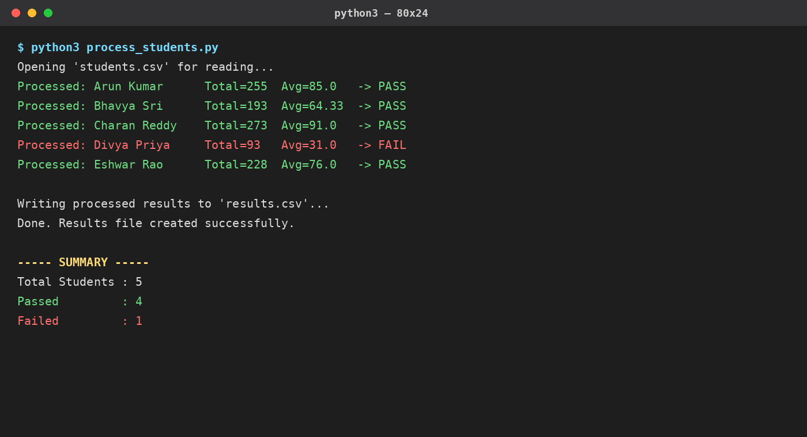
Implementation Output
Console log from running python3 process_students.py
11

Slide 12
Output File — results.csv
Newly created file with computed columns
Name | Roll No | Total | Average | Status
Arun Kumar | 101 | 255 | 85.0 | PASS
Bhavya Sri | 102 | 193 | 64.33 | PASS
Charan Reddy | 103 | 273 | 91.0 | PASS
Divya Priya | 104 | 93 | 31.0 | FAIL
Eshwar Rao | 105 | 228 | 76.0 | PASS
4
Students Passed
1
Student Failed
results.csv (raw)
Name,Roll No,Total,Average,Status
Arun Kumar,101,255,85.0,PASS
Bhavya Sri,102,193,64.33,PASS
Charan Reddy,103,273,91.0,PASS
Divya Priya,104,93,31.0,FAIL
Eshwar Rao,105,228,76.0,PASS
12

Slide 13
Key Takeaways
open()
with statement
Always the starting point — pick the right mode for the job
The safest pattern: guarantees the file closes, even on error
read vs write
csv module
read()/readline()/readlines() pull data in; write()/writelines() push it out
Handles quoting and delimiters correctly — safer than manual string splitting
try/except/finally
End-to-end flow
Wrap file I/O to handle missing files or bad data gracefully
Read → Process → Write is the pattern behind most real data programs
13

Slide 14
{ }
Thank You
Questions on File Handling in Python?
Deshaboina Dileep Kumar | 192424281RC | SIMATS Engineering
14

